Slide 1
Update on LPV Stages and Metrics for Cal/Val
Gabriela Schaepman-Strub (U Zurich)
LPV Subgroup meeting (ESA LPS side meeting)
11 May 2016

Slide 2
Overview
LPV overview paper status - GS
LPV validation stage table status - GS
Other similar approaches linked to CEOS (WG Climate) – GS
Maturity matrix (Bates and Privette, 2012)
Core-Climax Climate data record assessment (EUMETSAT)
Inconsistencies
of current LPV table,
with Maturity Matrices, and
thoughts on WGCV usage
Discussion - All
Decision on actions and work distribution - All

Slide 3
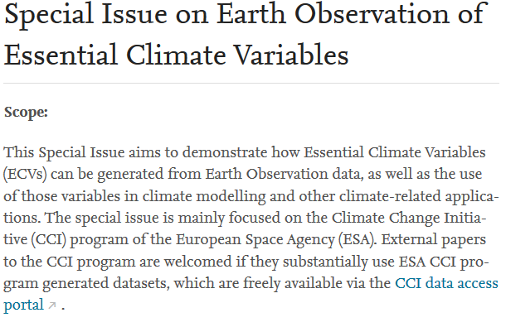
1. LPV Overview Paper Status
Submission of abstract to RSE special issue Editors: Michael Buchwitz, Emilio Chuvieco, Samantha Lavendern (deadline 31 May) http://www.journals.elsevier.com/remote-sensing-of-environment/call-for-papers/special-issue-on-earth-observation-of-essential-climate-vari/
Part of paper is update of validation stage table and assignment of validation stage to each variable covered by LPV
Notes:
Submission of papers: Authors who have been informed that their proposed paper is eligible for the SI (see “1. Abstracts”) can submit full papers during the submission period 1 June 2016 – 1 October 2016. The authors are kindly requested to follow RSE author guidelines. Papers submitted after 1 October 2016 will not be considered for the SI. Final publication: The printed version of the Special Issue will likely be available in the last quarter of 2017, assuming the standard length of the review process. However, accepted papers (after type-setting and proof-reading) will be made available as (citable) pre-print pdf file shortly (typically within a few weeks) after they have been accepted.

Slide 4
2. LPV Validation Stage Table (History)
Morisette 2006, 3 validation stages.
Baret, EOS report, 2006, introduced 4th stage
Nightingale, 2010, with updated validation stage table
LPV website (current version) slight changes to Nightingale, 2010 (‘rigorous’ instead of ‘robust’, publication already at stage 2)
Nightingale, J. Schaepman-Strub, G. Nickeson, J. and Baret, F. 2010. Assessing Satellite-derived Land Product Quality for Earth System Science Applications: Results from the CEOS LPV Sub-group. Proceedings of Earth Observation for Land-Atmosphere Interaction Science, SP-688, European Space Agency, 2011.

Slide 5
LPV Validation Stage Table (website version)

Slide 6
Short Discussion
What is the value/purpose of the LPV validation stage table for YOU?

Slide 7
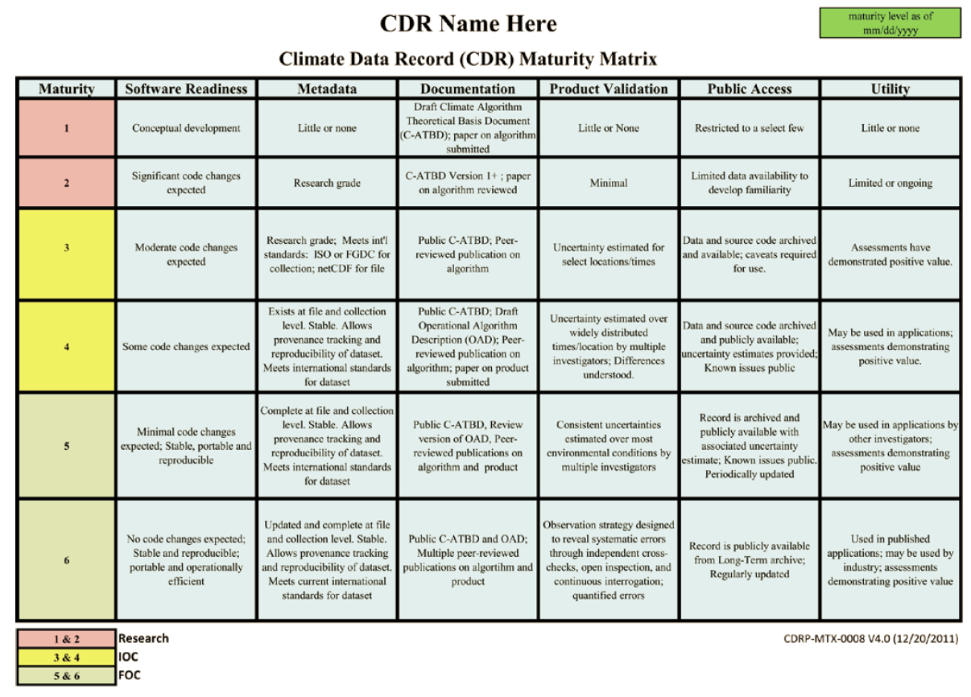
3. Other Existing Approaches (Maturity Matrix)
Bates, J. J., and J. L. Privette (2012), A maturity model for assessing the completeness of climate data records, Eos Trans. AGU, 93(44), 441, doi:10.1029/2012EO440006.
Notes:
6 columns in Maturity Matrix of Bates and Privette. 1 out of 6 is ‘product validation’.
Red – research capability (RC)
Yellow – Initial Operations Capability (IOC)
Green Full Operations Capability (FOC)

Slide 9
3. Other Existing Approaches (CORE-CLIMAX)
EUMETSAT, Core-Climax CDR Assessment Report, CC/EUM/REP/14/004, v1A Draft, 23 December 2014
Based on Bates and Privette, 2012
Extending the model to be applicable to climate data records in general (satellite, in situ, combined (sat + in situ), reanalysis)
Extending the validation column to include uncertainty assessment other than direct validation (e.g. downstream from instrument, propagated through algorithm)

Slide 10
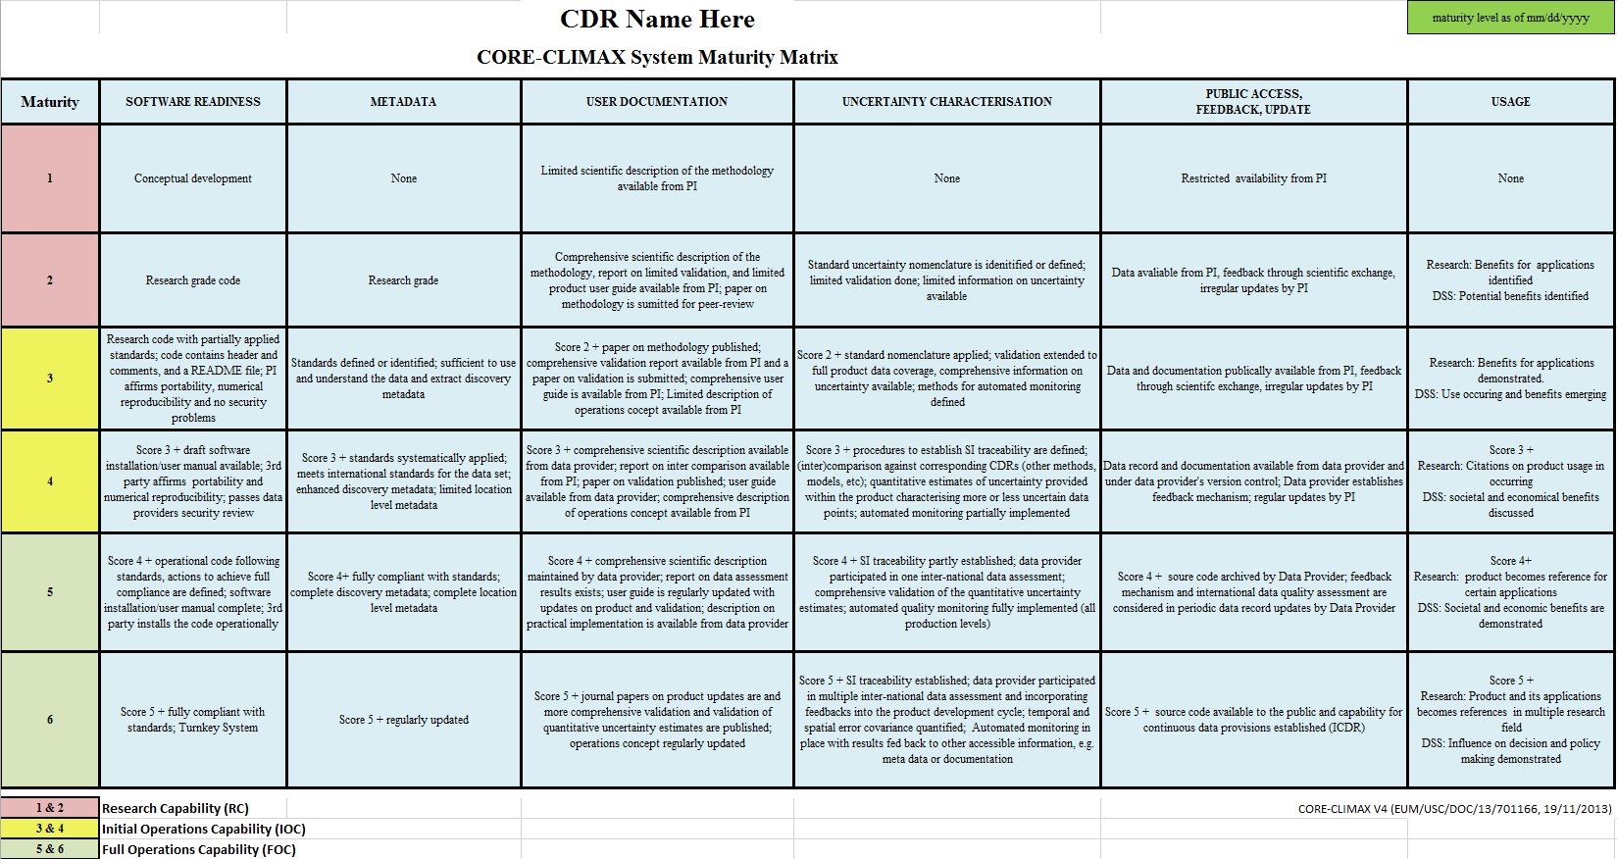
CORE-CLIMAX

Slide 11
Maturity | UNCERTAINTY CHARACTERISATION
1 | None
2 | Standard uncertainty nomenclature is identified or defined; limited validation done; limited information on uncertainty available
3 | Score 2 + standard nomenclature applied; validation extended to full product data coverage, comprehensive information on uncertainty available; methods for automated monitoring defined
4 | Score 3 + procedures to establish SI traceability are defined; (inter)comparison against corresponding CDRs (other methods, models, etc); quantitative estimates of uncertainty provided within the product characterising more or less uncertain data points; automated monitoring partially implemented
5 | Score 4 + SI traceability partly established; data provider participated in one inter-national data assessment; comprehensive validation of the quantitative uncertainty estimates; automated quality monitoring fully implemented (all production levels)
6 | Score 5 + SI traceability established; data provider participated in multiple inter-national data assessment and incorporating feedbacks into the product development cycle; temporal and spatial error covariance quantified; Automated monitoring in place with results fed back to other accessible information, e.g. meta data or documentation
Notes:
CORE-CLIMAX
Red – research capability (RC)
Yellow – Initial Operations Capability (IOC)
Green Full Operations Capability (FOC)

Slide 12
Sub-Criteria Summary
 |  |  |  | CLIMATE DATA RECORD (CDR) MATURITY EVALUATION GUIDELINES
Maturity | UNCERTAINTY CHARACTERISATION | Standards¹ | Validation | Uncertainty quantification | Automated Quality Monitoring
1 | None | None | None | None | None
2 | Standard uncertainty nomenclature is idenitified or defined; limited validation done; limited information on uncertainty available | Standard uncertainty nomenclature is identified or defined | Validation using external reference data done for limited locations and times | Limited information on uncertainty arising from systematic and random effects in the measurement | None
3 | Score 2 + standard nomenclature applied; validation extended to full product data coverage, comprehensive information on uncertainty available; methods for automated monitoring defined | Score 2 + Standard uncertainty nomenclature is applied | Validation using external reference data done for global and temporal representative locations and times | Comprehensive information on uncertainty arising from systematic and random effects in the measurement | Methods for automated quality monitoring defined
4 | Score 3 + procedures to establish SI traceability are defined; (inter)comparison against corresponding CDRs (other methods, models, etc); quantitative estimates of uncertainty provided within the product characterising more or less uncertain data points; automated monitoring partially implemented | Score 3 + Procedures to establish SI traceability are defined | Score 3 + (Inter)comparison against corresponding CDRs (other methods, models, etc) | Score 3 + quantitative estimates of uncertainty provided within the product characterising more or less uncertain data points | Score 3 + automated monitoring partially implemented
5 | Score 4 + SI traceability partly established; data provider participated in one inter-national data assessment; comprehensive validation of the quantitative uncertainty estimates; automated quality monitoring fully implemented (all production levels) | Score 4 + SI traceability partly established | Score 4 + data provider participated in one inter-national data assessment | Score 4 + temporal and spatial error covariance quantified | Score 3 + monitoring fully implemented (all production levels)
6 | Score 5 + SI traceability established; data provider participated in multiple inter-national data assessment and incorporating feedbacks into the product development cycle; temporal and spatial error covariance quantified; Automated monitoring in place with results fed back to other accessible information, e.g. meta data or documentation | Score 5 + SI traceability established | Score 4 + data provider participated in multiple inter-national data assessment and incorporating feedbacks into the product development cycle | Score 5 + comprehensive validation of the quantitative uncertainty estimates and error covariance | Score 5 + automated monitoring in place with results fed back to other accessible information, e.g. meta data or documentation

Slide 13
4. Inconsistencies of current LPV table,…
Missing indication that stages build up on each other (stage 2 = stage 1 + additional critera, stage 3 = stage 2 + additional criteria, etc.) -> include
Number of sites increasing with stage, but not clearly defined: stage 1 < 30, stage 2 ‘significant set of locations… over globally representative locations’, stage 3 ‘multiple locations …. representing global conditions’ -> consolidate and refer to variable-specific protocols?
Distribution of sites not clearly defined: stage 1 only number, stage 2 ‘globally representative’, etc. -> what does this mean? Stratified per ecosystem, variable histogram, or spatially (e.g. latitudinal zone) etc.? -> definition will differ with variable! -> consolidate and refer to variable-specific protocols?
Same with requirements on temporal component -> consolidate and refer to variable-specific protocols?
Statistically rigorous versus robust (include criteria on required metrices, statistical approaches?) -> define in more detail, consistent with GUM/VIM?

Slide 14
Quality criteria of reference data missing (e.g. fiducial reference data with included uncertainties, unertainties of intercomparison data set) -> include additional stage (e.g. 5 where quality of reference data is emphasized or at much earlier stage?)
Keep LPV application in mind (we do not want to be limited to Climate Data Records, criteria need to be open enough to be useful for different user communities (e.g. time range needed, uncertainty metrices, etc.)).

Slide 15
4. … inconsistencies with and between different approaches
6 stages, starting with ‘none’ (Bates and CoreClimax); 4 stages for LPV
LPV stage 4 – new product version and time series expansion; covered by CoreClimax as new product (with full assessment) and by automated validation
Bates and LPV validation only; CoreClimax including broader uncertainty assessment (uncertainty characterization based on algorithm)
Bates and LPV are missing uncertainty characterization of reference data (fiducial reference data); included in CoreClimax as ‘SI traceability’
CoreClimax uncertainty characterization column as summary of Sub-Criteria columns

Slide 16
4. … and thoughts on WGCV usage.
Miguel – what is the request from WGCV?
[Response from WGCV Plenary]:
Sorting out how we proceed with the terminology / Who does what and when ?
What is our understanding for a validation metrics from the different subgroups (and finally WGCV chair) perspective ?
How we collect the eventually different views and how do we proceed to achieve from the treasure of existing approaches in the different communities a way forward which leads to a common definition/path forward (which may also be extended by each individual community if needed in certain limits) ?

Slide 17
5. Discussion
Other existing or developing tables of relevance that were missed in this presentation (e.g. QA4ECV)?
Should LPV adopt the Maturity Matrix (Bates or CoreClimax) approach?
CEOS definition of validation ‘CEOS defines validation as the process of assessing the quality of the data products derived from system outputs by independent means’ (Morisette, TGARS 06, citing Justice, IJRS, 2000) -> Bates in line with this definition, CoreClimax goes beyond validation (uncertainty characterization) -> adopting the CoreClimax definition might go beyond the LPV mission?
GS sees 2 potential solutions 1. ‘soft’ update of current LPV table (green suggestions on previous slide), include it in paper, work on WGCV and maturity matrix consolidation in a second step 2. directly consolidate with maturity matrix (Jörg Schulz welcomed the discussion on this topic!)
Notes:
Jörg Schulz: To some extent we are obliged to provide explanation of terminology also in the ongoing FIDCUEO project (www.fiduceo.eu) in the next few years but I think getting a few people together to work on this across domains (atmosphere, land and ocean , cryosphere) could be fruitful.

Slide 18
6. Actions and Work Distribution
Next steps
Paper abstract submission (31 May)
Consolidation within LPV -> who is interested to contribute?
Application to all variables
Paper finalization
Outreach to WGCV for general application (WGCV chair, IVOS) -> Miguel?
Outreach to WG Climate (Bates, Schulz) -> who is interested to contribute?
Actions and work distribution

